Slide 1

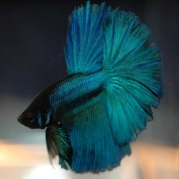
01
MULTICLASS FISH IMAGE CLASSIFICATION
Presented by DevaPriya

Slide 2
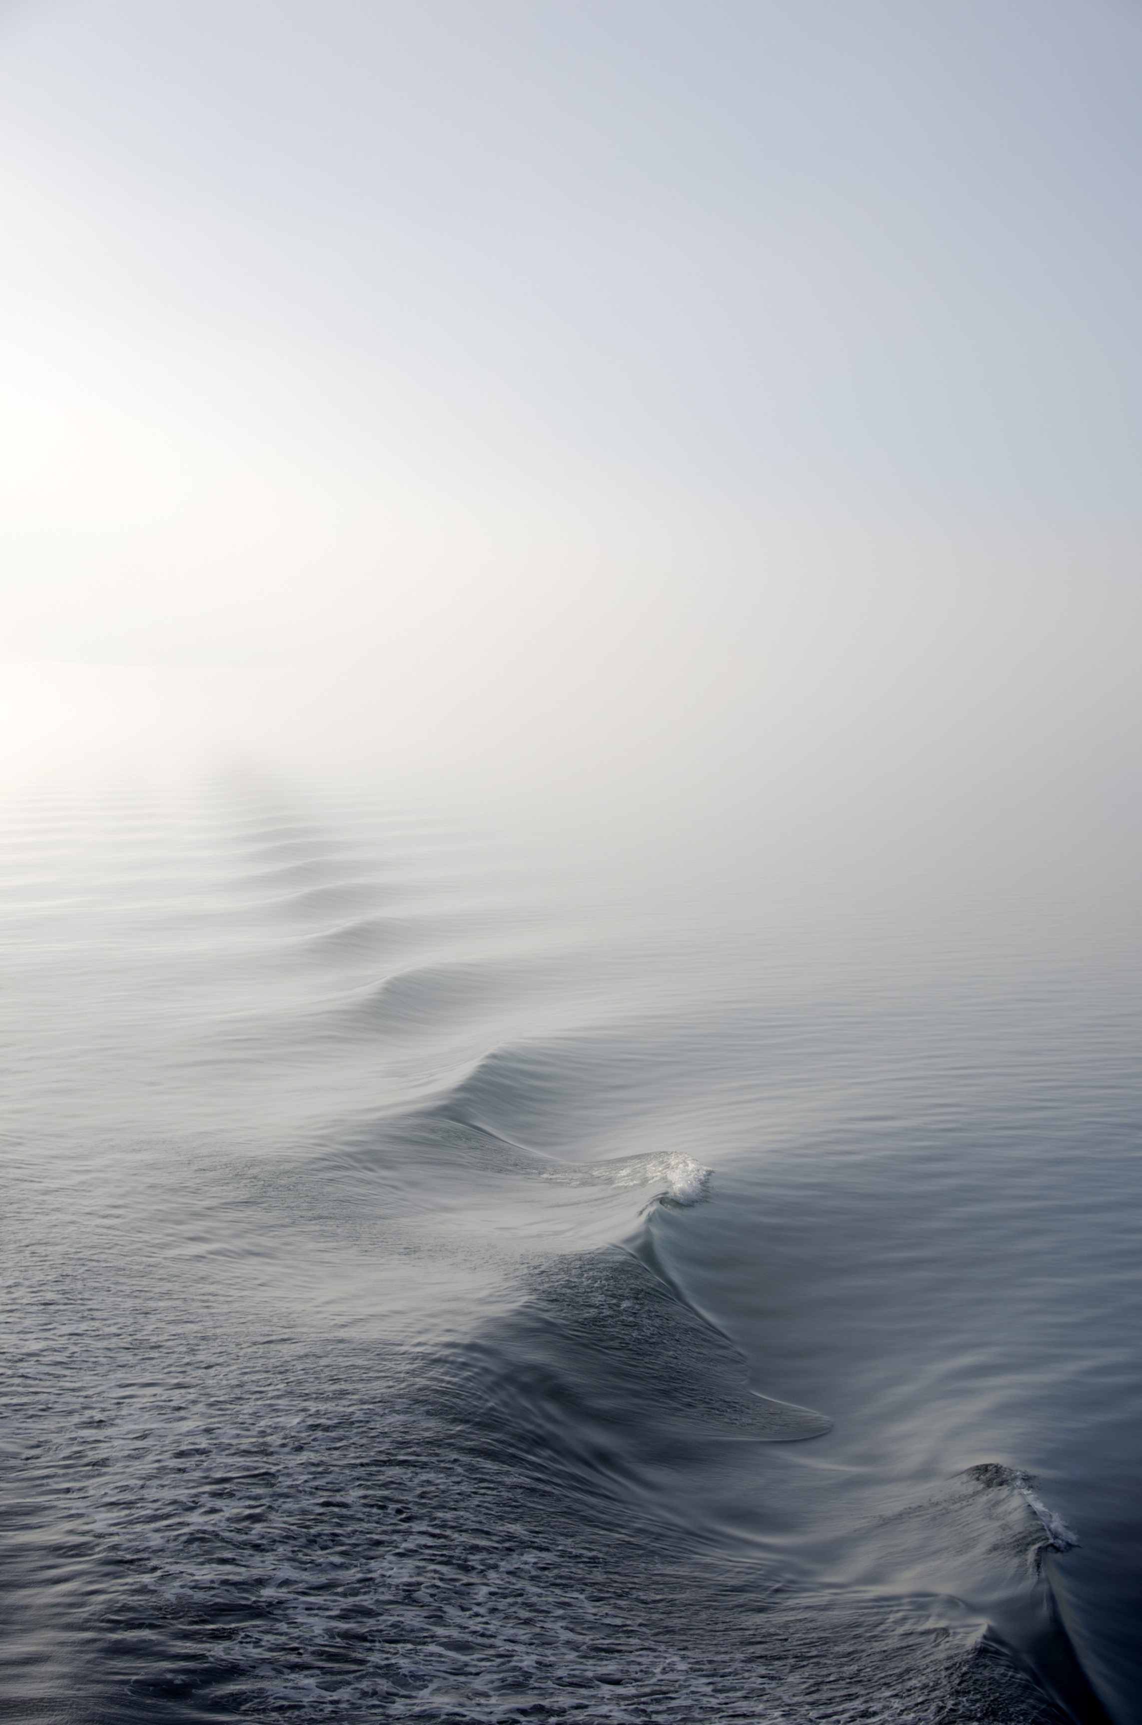
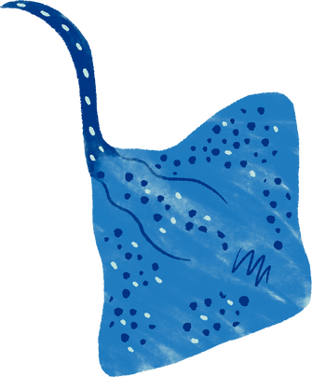

02
01
DEEP LEARNING-BASED
IMAGE
CLASSIFICATION
PROJECT
Python
02
TensorFlow/Keras
03
Streamlit

Slide 3
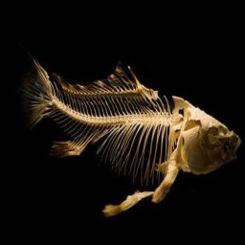
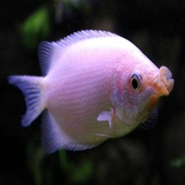
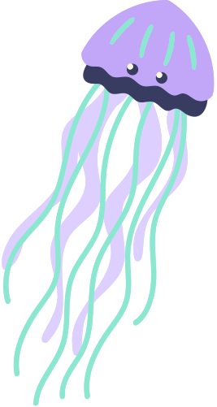
03
PROBLEM STATEMENT
The goal is to classify fish images into multiple species.
Use deep learning models to achieve accurate classification.
Compare models and deploy the best one as a web app.

Slide 4
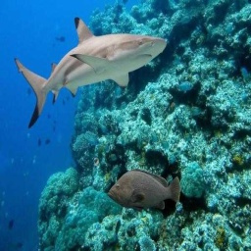
04
OBJECTIVES
Build a CNN model from scratch.
Use pre-trained models (Transfer Learning)
Evaluate and compare model performance.
Deploy the best model using Streamlit.

Slide 5
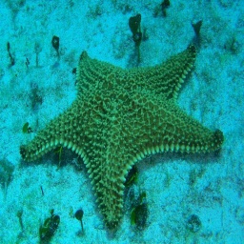
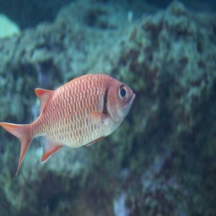
05
SKILLS GAINED
Deep Learning
TensorFlow / Keras
Data Preprocessing
Transfer Learning
Model Evaluation
Streamlit Deployment
Visualization

Slide 6
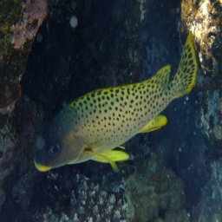
Fradel and Spies
06
Model Architectures Used
CNN (Custom Model)
VGG16
ResNet50
MobileNet
InceptionV3
EfficientNetB0

Slide 7
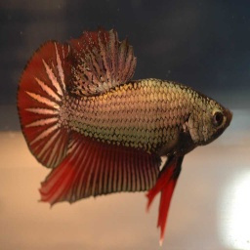
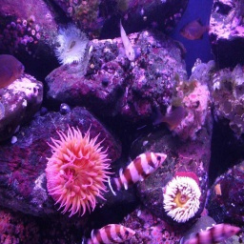
07
Upload image → Model predicts fish species
Displays confidence score
User-friendly web interface
Fast and accurate predictions
StREAMLIT APP

Slide 8
THANK YOU

